Slide 1
Practical Training Seminar on “Android App Development”
Submitted By:
Niten Kumawat
Computer Science & Engineering

Slide 2
Centre for Electronic Governance, Jaipur (Established by Department of Technical Education, Govt. of Rajasthan)
Centre for Electronic Governance is an autonomous body of Government of Rajasthan under the Department of Technical Education.
CEG get recognition in IT Training programs like Big data, Hadoop, AWS Cloud Computing, CCNA, Android App Development, Java, ASP.NET, ASP.NET MVC 5 using Razor, PHP MySQL, AutoCAD, RedHat Certification, C, C++, Embedded Training programs etc. in Jaipur.
CEG also Conduct Summer Training programs for MCA, M.Sc., B.Tech, M.Tech and for Diploma students.

Slide 3
What is Android
Android is the name of the mobile operating system owned by American company, Google. It most commonly comes installed on a variety of smart phones and tablets from a host of manufacturers offering users access to Google’s own services like Search, YouTube, Maps, Gmail and more.
Android is an open source and Linux-based Operating System for mobile devices such as smartphones and tablet computers. Android was developed by the Open Handset Alliance, led by Google, and other companies.

Slide 4
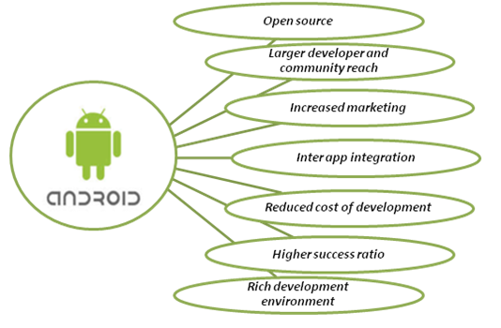
Why Android

Slide 5
Features of Android
Beautiful UI – User Interface
Connectivity – GSM, CDMA, Bluetooth, Wi-Fi, WiMAX.
Data Storage – SQLite
Media support
Messaging
Web browser
Multi-touch
Multi-tasking
Resizable widgets

Slide 6
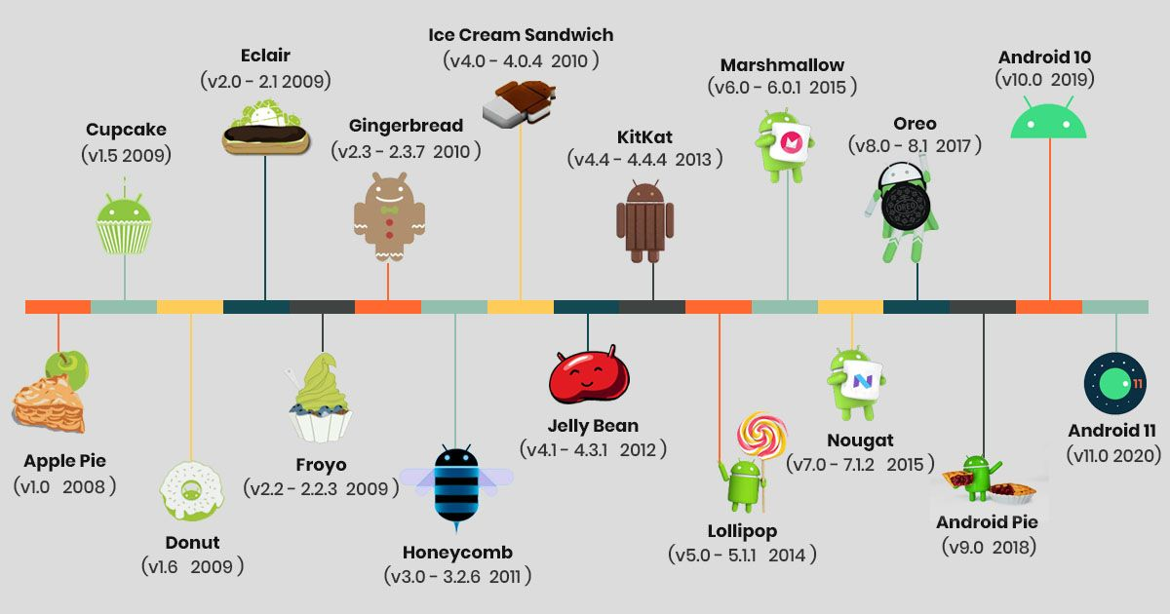
Versions of Android

Slide 7
Hardware & SoftwareRequirement
Operating System:
Windows 7, Windows 8 or Windows 10
Linux
Hardware:
Processor (CPU) with 2 gigahertz (GHz) frequency or above
A minimum of 4GB of RAM
Monitor Resolution 1024 X 768 or higher
A minimum of 20 GB of available space on the hard disk
Internet Connection
Software:
Editor : Android Studio SDK, JDK 1.8
ADB Driver
Database : SQLite

Slide 8

API Levels
API Level is an integer value that uniquely identifies the
framework
API revision offered by a version of the Android platform.

Slide 9
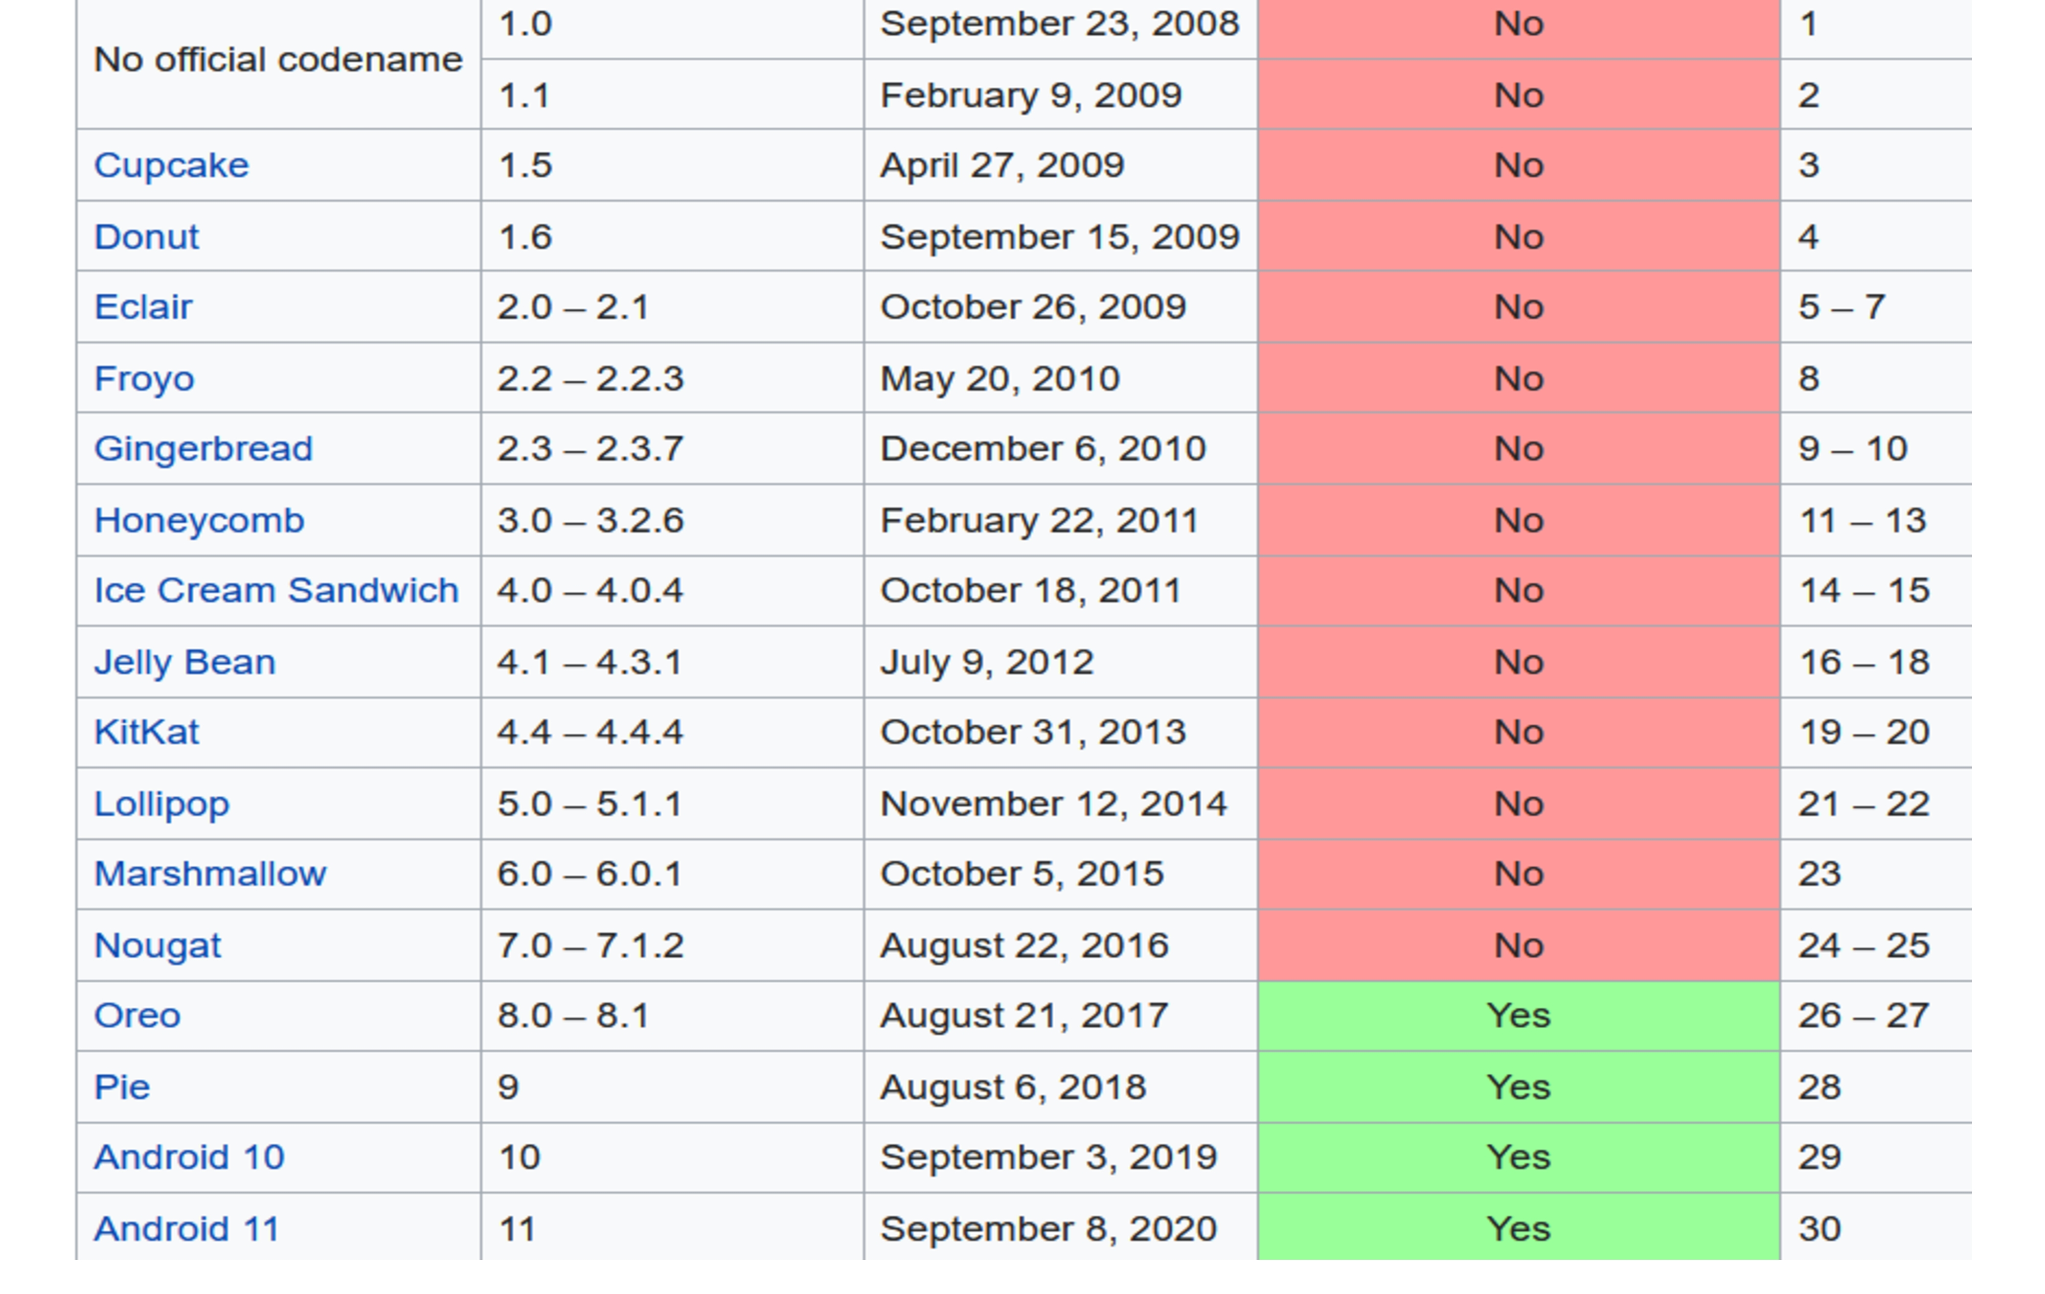

Slide 10
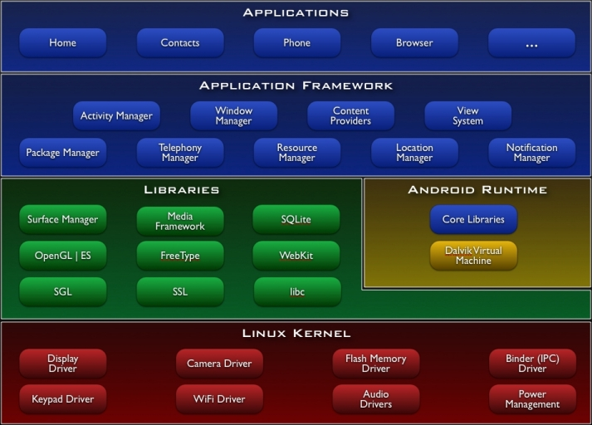
Architecture

Slide 11
Introduction to Java
Java is a general-purpose programming language that is concurrent, class-based, object-oriented. Java is a popular general-purpose programming language and computing platform. It is fast, reliable, and secure.

Slide 12
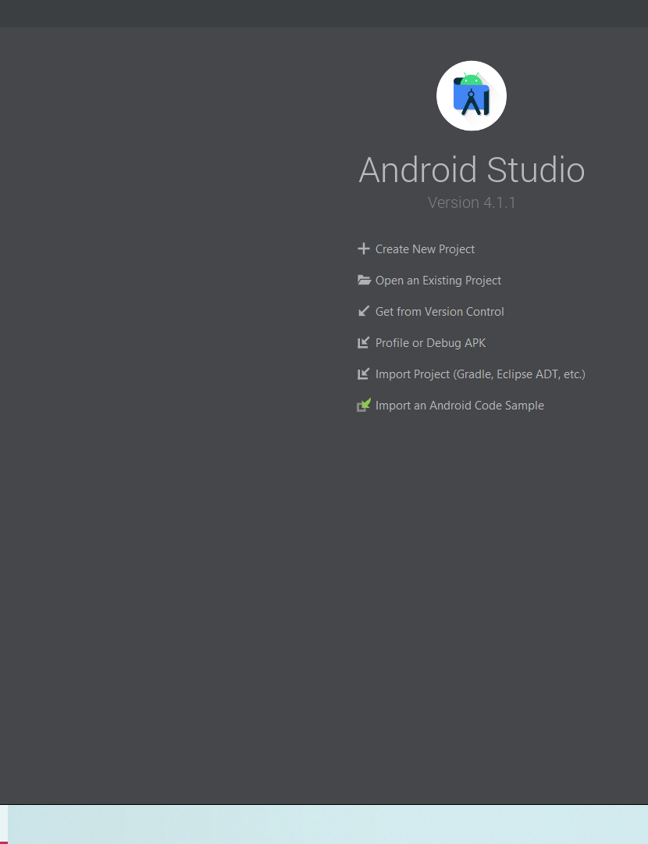
Create A Project In Android

Slide 13
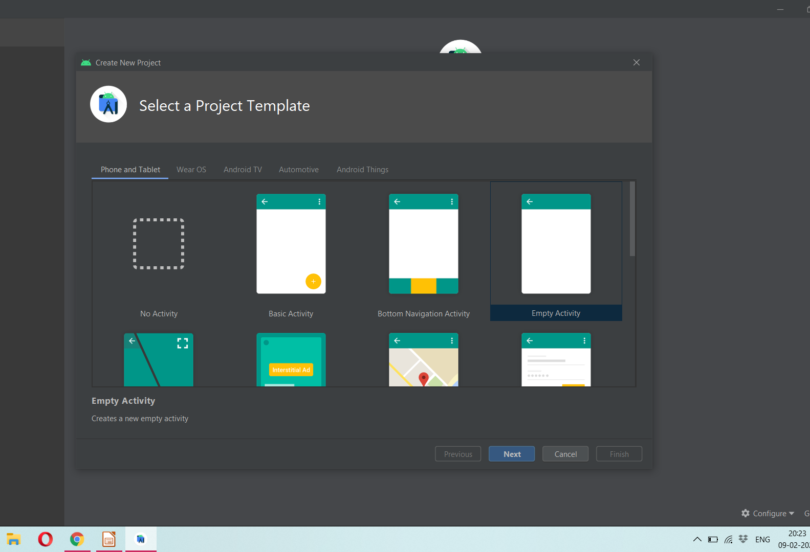

Slide 14
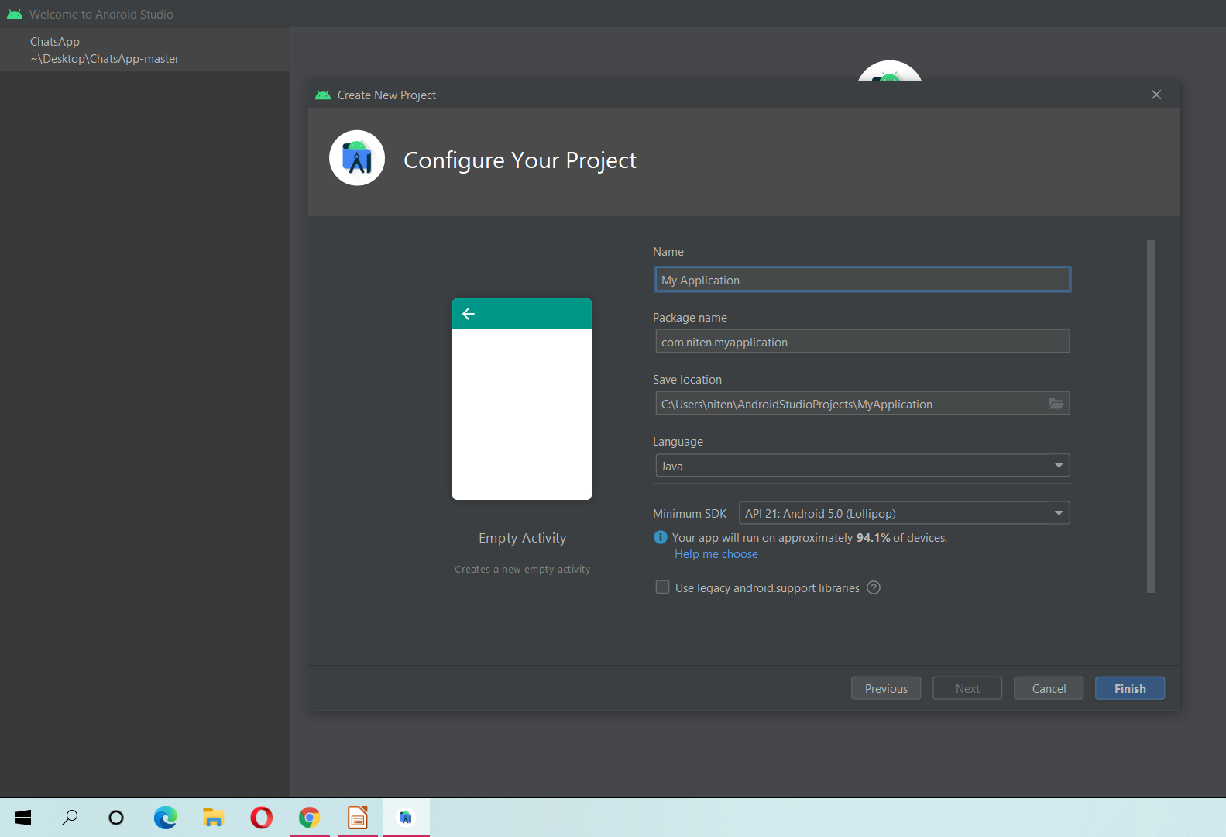

Slide 15
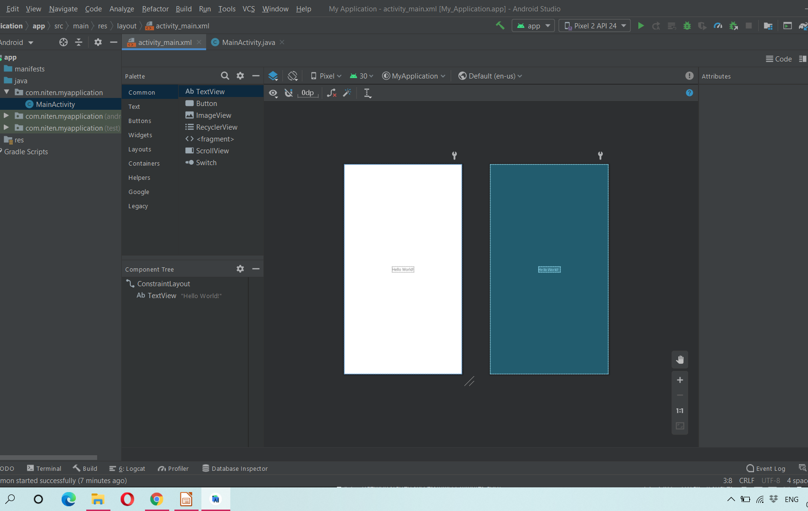

Slide 16
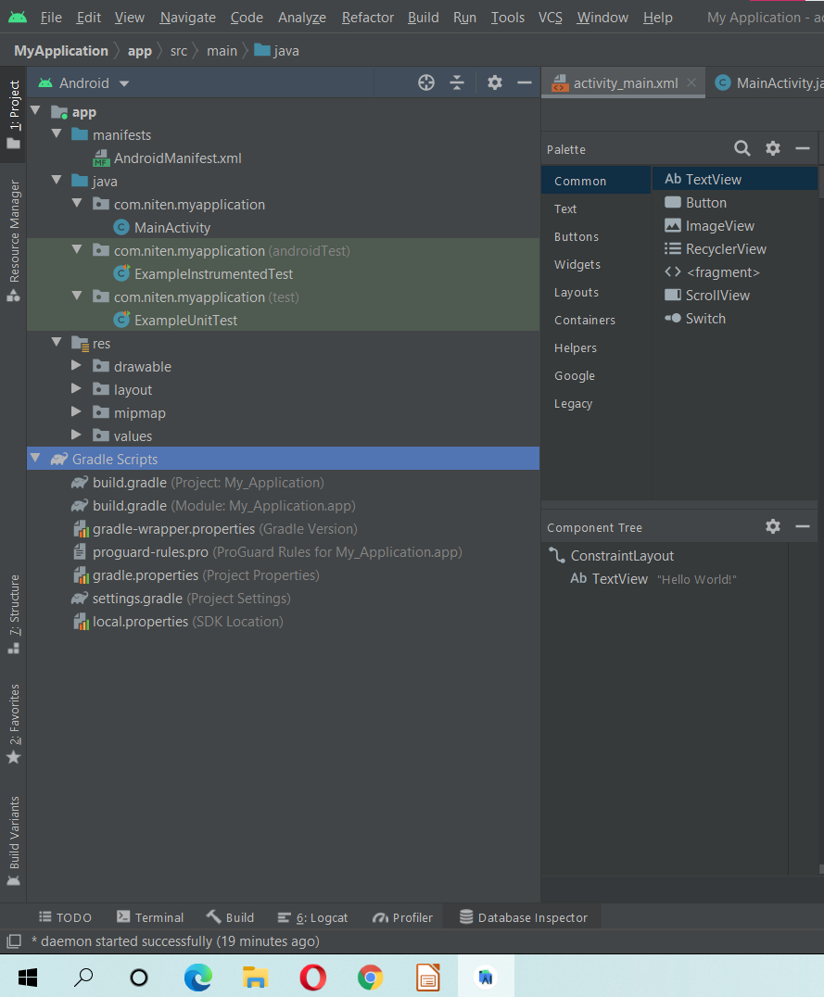
Project Files

Slide 17
Emulator
The Android Emulator simulates a device and displays it on your development computer
The Android Emulator is fast, powerful, and feature-rich. It can transfer information faster than using a connected hardware device, speeding up the development process

Slide 18

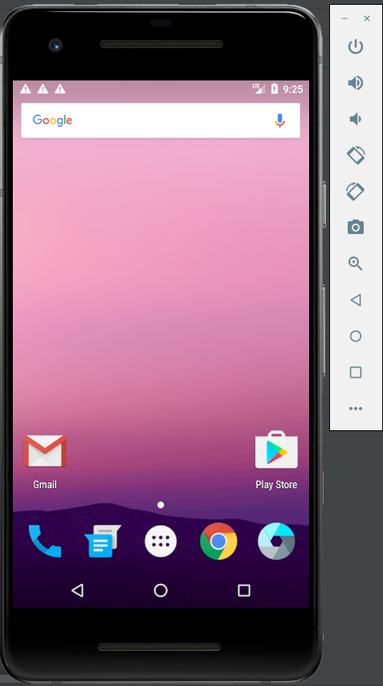

Slide 19
ADB
ADB, Android Debug Bridge, is a utility included with Google’s Android SDK. ADB can control your device over USB from a computer, copy files back and forth, install and uninstall apps, run shell commands, and more.
Though ADB drier output of Android development show on mobile device.

Slide 20
Core Libraries
System C library, the standard C system library, tuned for embedded Linux-based devices
Media Libraries, support playback and recording of many popular audio and video formats, as well as image files, including MPEG4, H.264, MP3, AAC, AMR, JPG, and PNG
Surface Manager, manages access to the display subsystem and seamlessly composites 2D and 3D graphic layers from multiple applications
WebKit, a modern web browser engine which powers both the Android browser and an embeddable web view
SGL, the underlying 2D graphics engine
3D libraries, an implementation based on OpenGL ES 1.0 APIs
FreeType , bitmap and vector font rendering
SQLite , a powerful and lightweight relational database engine

Slide 21
Dalvik Virtual Machine
Android custom implementation virtual machine
Provides application portability and runtime consistency
Runs optimized file format (.dex) and Dalvik bytecode
Java .class / .jar files converted to .dex at build time
Designed for embedded environment
Supports multiple virtual machine processes per device
Highly CPU-optimized bytecode interpreter
Efficiently Using runtime memory
Core Libraries
Core APIs for Java language provide a powerful, yet simple and familiar development platform

Slide 22
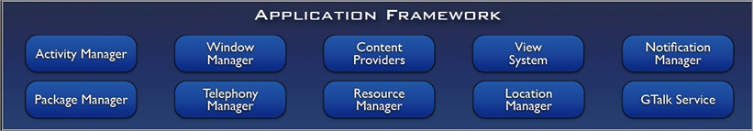
Application Framework
Simplify the reuse of components
Applications can publish their capabilities and any other application may then make use of those capabilities
Applications is a set of services and systems, include
Views system, content providers, resources manager and so on

Slide 23
Activity Manager, manages the lifecycle of applications and provides a common navigation backstack
Notification Manager, enables all applications to display custom alerts in the status bar
Resource Manager, providing access to non-code resources such as localized strings, graphics, and layout files
Content Providers, access data from other applications (such as Contacts), or to share their own data
Views, used to build an application, including lists, grids, text boxes, buttons, and even an embeddable web browser

Slide 24
Android Layout
An Android layout is a class that handles arranging the way its children appear on the screen. Anything that is a View (or inherits from View) can be a child of a layout
Anything that is a View (or inherits from View) can be a child of a layout.
Android supports the following ViewGroups:
LinearLayout
AbsoluteLayout
TableLayout
RelativeLayout
FrameLayout
ScrollView

Slide 25
Liner Layout
Liner layout : all children aligned in single direction horizontally or vertically
The Linear Layout arranges views in a single column or single row. Child views can either be arranged vertically or horizontally.
Example:-
<LinearLayout xmlns:android="http://schemas.android.com/apk/res/android" android:layout_width="fill_parent“
android:layout_height="wrap_content"
android:orientation="vertical">
</LinearLayout>

Slide 26
1. orientation: The orientation attribute used to set the childs/views horizontally or vertically. In Linear layout default orientation is vertical.
2. gravity: The gravity attribute is an optional attribute which is used to control the alignment of the layout like left, right, center, top, bottom etc.
3. layout_weight: The layout weight attribute specify each child control’s relative importance within the parent linear layout.

Slide 27
<LinearLayout xmlns:android="http://schemas.android.com/apk/res/android" android:layout_width="match_parent" android:layout_height="match_parent"
android:gravity="right"
android:orientation="horizontal">
</LinearLayout>

Slide 28
Relative Layout
The Relative Layout is very flexible layout used in android for custom layout designing. It gives us the flexibility to position our component/view based on the relative or sibling component’s position. Just because it allows us to position the component anywhere we want so it is considered as most flexible layout.
Relative Layout, you can use “above, below, left and right” to arrange the component’s position in relation to other component.

Slide 29
above: Position the bottom edge of the view above the given anchor view ID and must be a reference of the another resource in the form of id. Example, android:layout_above=”@+id/textView” .
alignBottom: alignBottom is used to makes the bottom edge of the view match the bottom edge of the given anchor view ID and it must be a reference to another resource, in the form of id.
Example:
android:layout_ alignBottom =”@+id/button1″

Slide 30
Intent
An Intent is a messaging object.
Use to send Request an action from another app component.
Use for send data or message to one activity to another activity.
Send to control one activity to another activity
Intent I =newIntent(MainActivity.this,Main2Activity.class);
StartActivity(i);

Slide 31
Send Control One activity to web address
Intent i= new Intent (Intent.ACTION_VIEW);
i.setData(Uri.parse("http://www.ceg.rajasthan.gov.in"));
startActivity(i);

Slide 32
Web View
Android webview is used to display webpage in android. The web page can be loaded from same application or URL. It is used to display online content in android activity.
The android.webkit.WebView is the subclass .
The loadUrl() method of Android webview class are used to load and display web page.

Slide 33
Android Toast
Andorid Toast can be used to display information for the short period of time. A toast contains message to be displayed quickly and disappears after sometime.
The android.widget.Toast class is the subclass of java.lang.Object class.
Toast.makeText(getApplicationContext(),"Hello Alwar",Toast.LENGTH_SHORT).show();

Slide 34
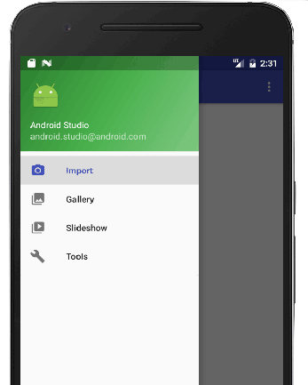
Navigation Drawer
The navigation drawer is a UI panel that shows your app's main navigation menu.
It is hidden when not in use, but appears when the user swipes a finger from the left edge of the screen

Slide 35
SQLite
SQLite is an open-source relational database i.e. used to perform database operations on android devices such as storing, manipulating or retrieving persistent data from the database.
It is embedded in android bydefault. So, there is no need to perform any database setup or administration task.
SQLite is a Structure query base database, open source, light weight, no network access and standalone database.

Slide 36
Google Map
Android allows us to integrate Google Maps in our application. For this Google provides us a library via Google Play Services for using maps. In order to use the Google Maps API, you must register your application on the Google Developer Console and enable the API.
An API key is needed to access the Google Maps servers. This key is free and you can use it with any of your applications. If you haven’t created project, you can follow the below steps to get started:
Open Google developer console and signin with your gmail account: https://console.developers.google.com/project

Slide 37

Project :Kabutar
What we build :
Phone Authentication
Private Chat
Stories like Whatsapp
Reactions like Instagram
Delete for Me and Everyone
Last Message
Shaimmer Animations
Advanced Layouts

Slide 38
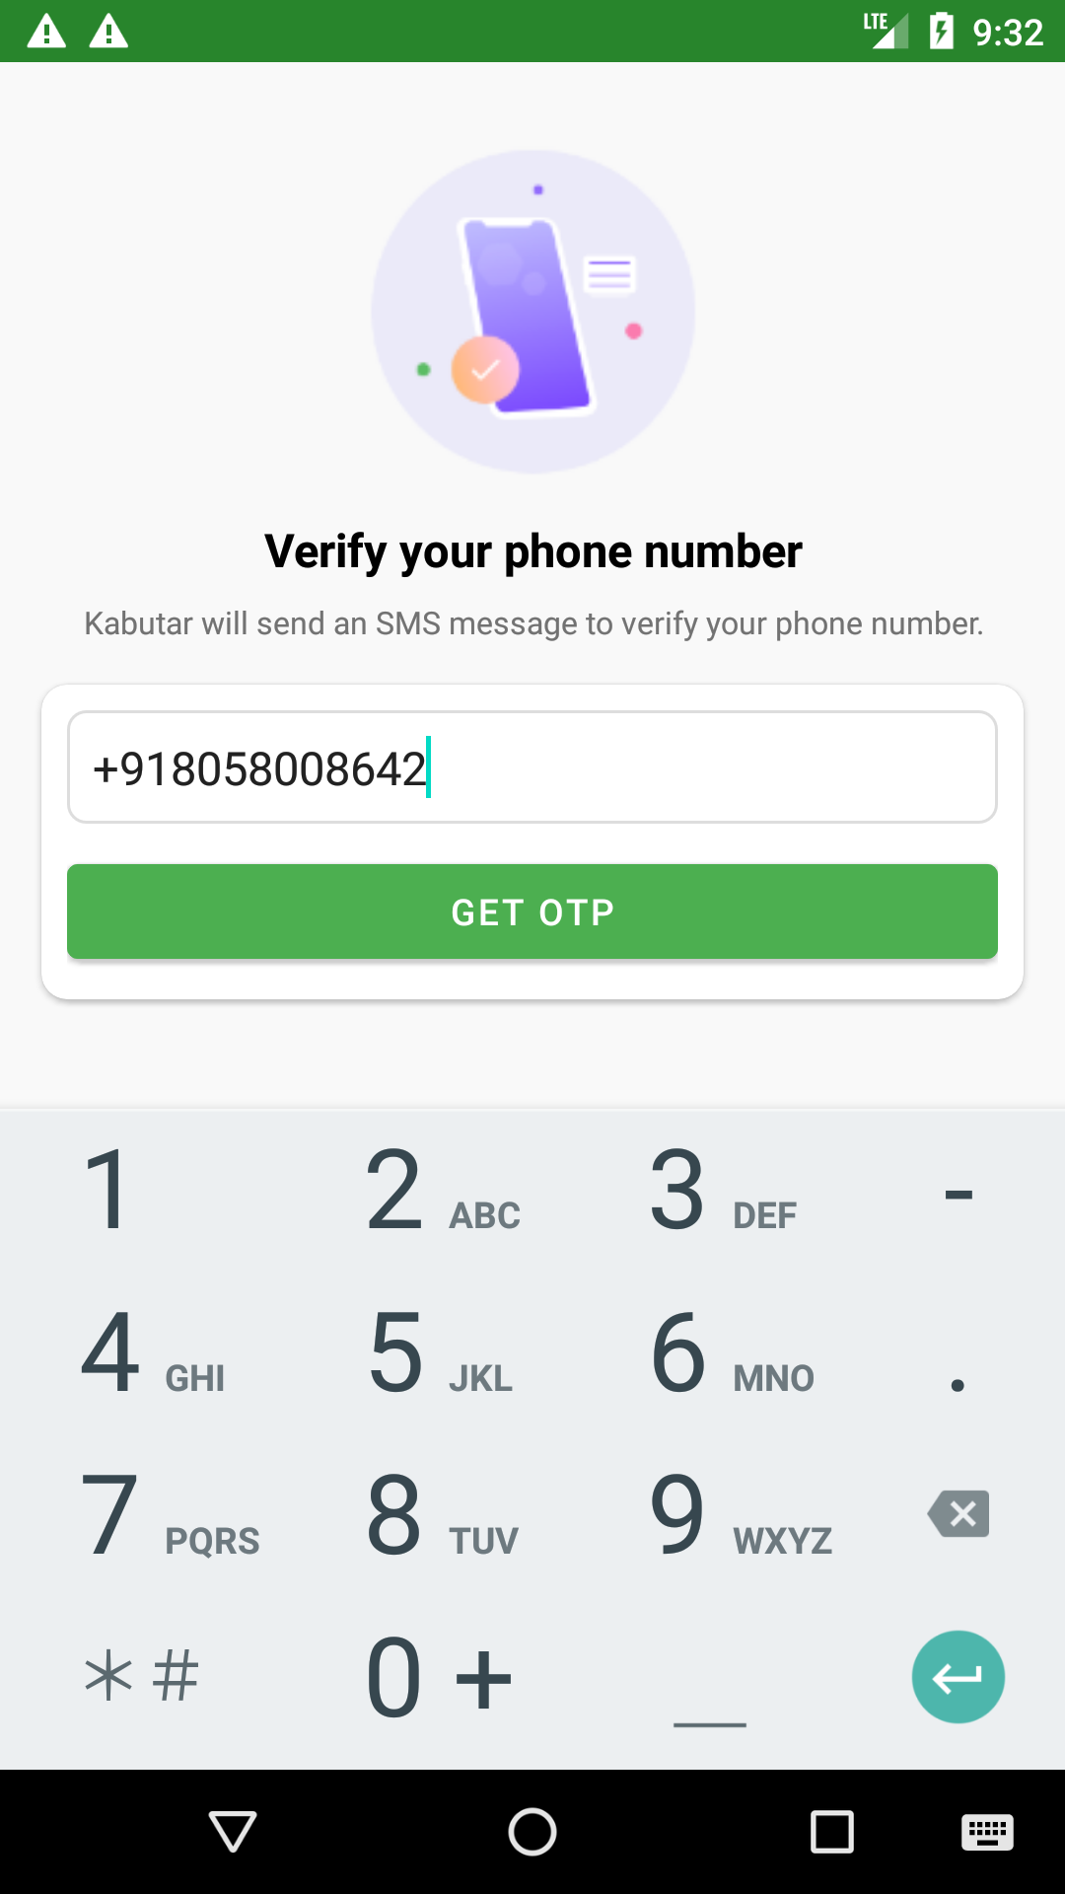
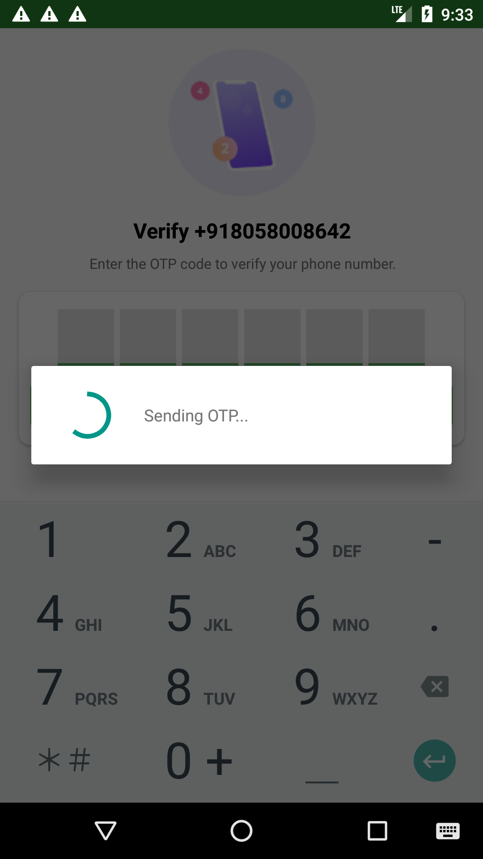
Phone Authentication

Slide 39
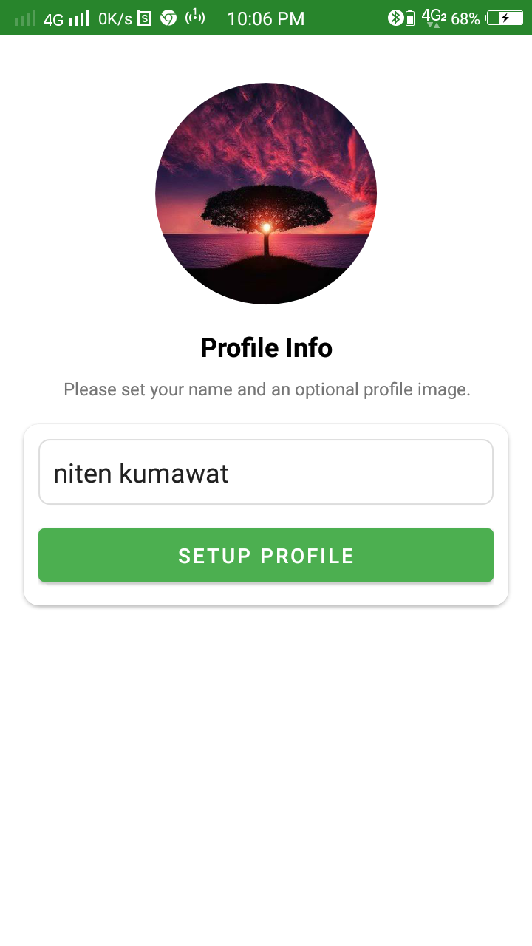
Profile setup

Slide 40
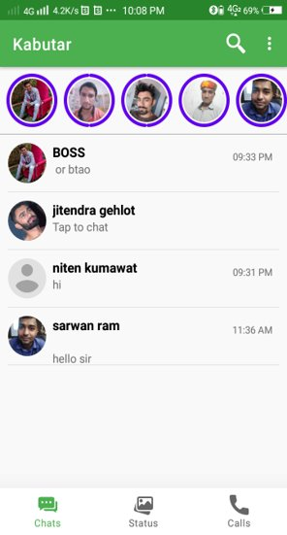
Features of App
Chat With Friends
Add Stories
Last message
Calls
Set Reactions
Invite Friends
Delete for Me and Everyone

Slide 41

Do you have any queries ?

Slide 42

Thanks

